Slide 1
TIME SERIES ANALYSIS
IS THERE A TREND?
Identify the trend
Underlying reasons
WHERE IS THE PEAK?
Identify the peak season
Quantify the peak sales amount
WHICH MATERIAL SELLS MORE?
Identify the popular materials and categories
Quantify the overall sale

Slide 2
OVERALL SETUP
Data meeting the following conditions were extracted –
i. BOMLINETYPE = Material
ii. Amount > 0
Time period under consideration is April 2016 to March 2020
The Y-axis (vertical axis) indicates the sale amount (in Indian rupees)
The X-axis (horizontal axis) indicates the corresponding time points
The following table indicates the number of stores from where data is collected for each financial year –
 | 2016-2017 | 2017-2018 | 2018-2019 | 2019-2020
Gold | 24 | 25 | 26 | 27
Silver | 24 | 25 | 26 | 27
Diamond | 24 | 25 | 26 | 27
Platinum | 22 | 25 | 26 | 27

Slide 3

Monthly Analysis on: ITEM TYPE
Each month/year is taken as a time point and four years of data are plotted
The Y-axis (vertical axis) indicates the sale amount (in crores of rupees) of the corresponding material type, i.e. Gold, Diamond, Silver and Platinum for each time point
The X-axis (horizontal axis) indicates each month/year of the mentioned time period

Slide 4
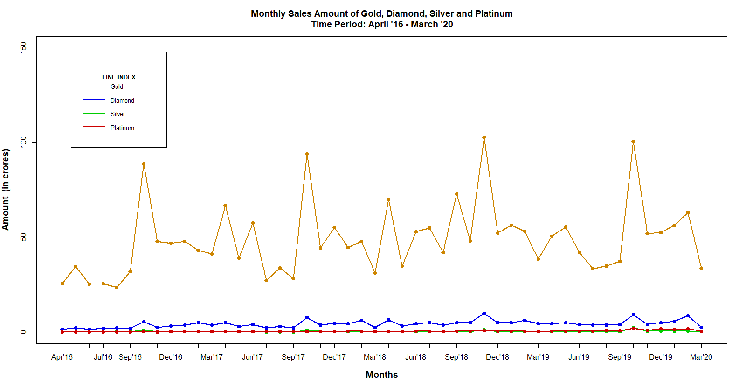

Slide 5
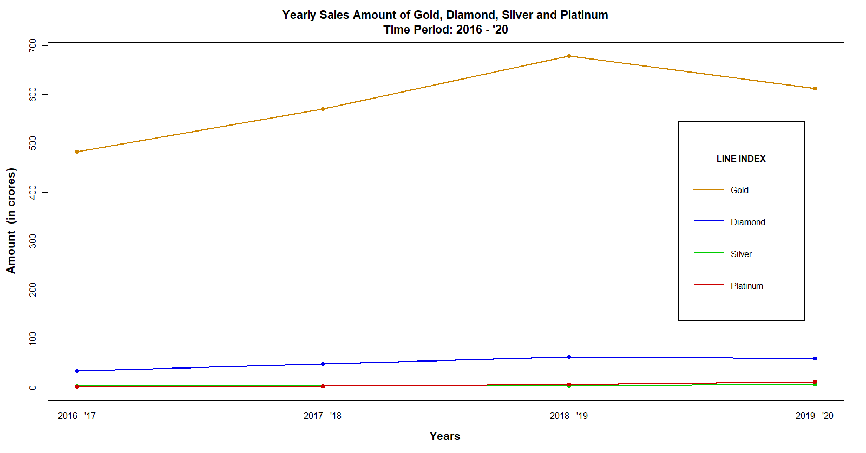

Slide 6
Comments :
Every material attains a peak in October – November
Gold brings maximum revenue followed by diamond, platinum and silver in respective order
Gold attains maximum sales amount in November 2018, amounting to ₹102,70,54,502 (approximately 102.7 crores)
Diamond attains maximum sales amount in November 2018, amounting to ₹9,82,60,370 (approximately 9.82 crores)
Silver attains maximum sales amount in October 2019, amounting to ₹2,26,86,587 (approximately 2.26 crores)
Platinum attains maximum sales amount in October 2019, amounting to ₹1,92,84,747 (approximately 1.93 crores)

Slide 7
Analysis on : ORNAMENT CATEGORIES
Each month/year (both are studied in separate graphs) is taken as a time point and four years of data are plotted. Each graph indicates the time series data corresponding to a specific material, i.e. Gold, Platinum, Silver and Diamond
The Y-axis (vertical axis) indicates the sale amount (in lakhs of rupees) of the corresponding material type, i.e. Gold, Diamond, Silver and Platinum for each time point
The X-axis (horizontal axis) indicates each month of the mentioned time period
Each graph is a multiple line diagram indicating the sales amount of the ornament categories (under a specific Item Type).
For better visualization, the major ornament categories are studied individually while the remaining categories are condensed into a single category titled as ‘Others’

Slide 8
Multiple line diagram of : DIAMOND
Categories under study :
i. DLR
ii. DT
iii. DN
iv. DPN
v. Others (57)

Slide 9
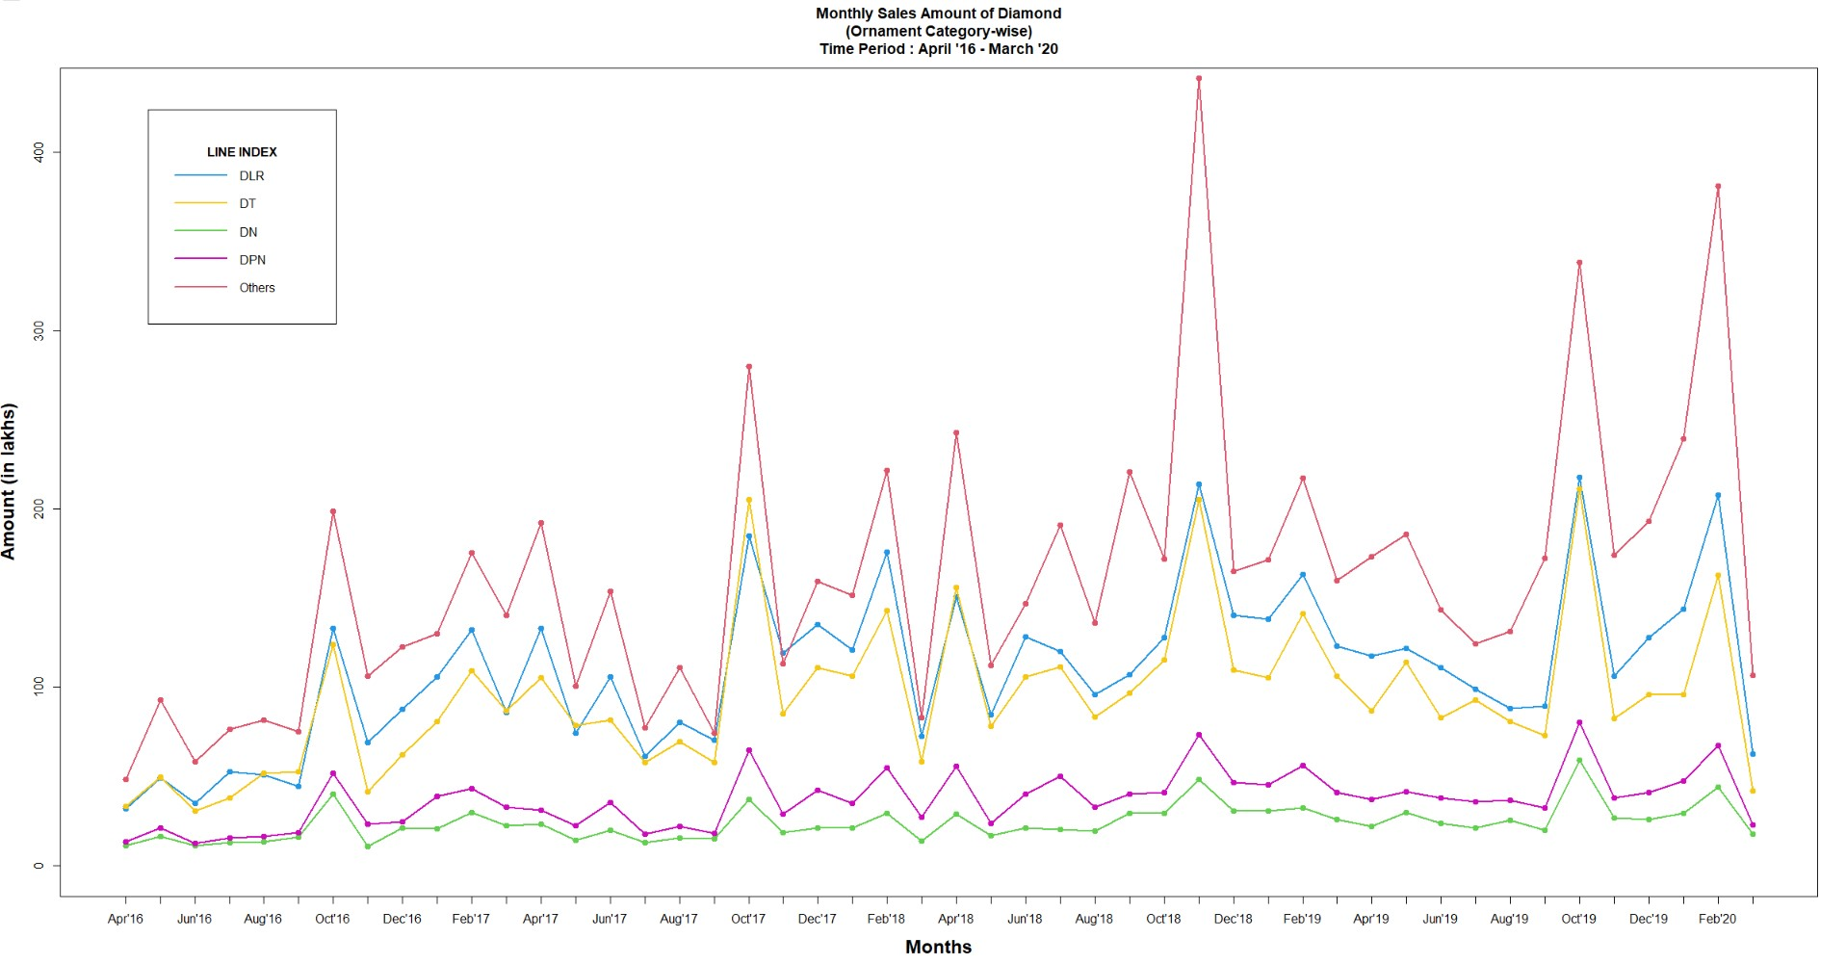

Slide 10
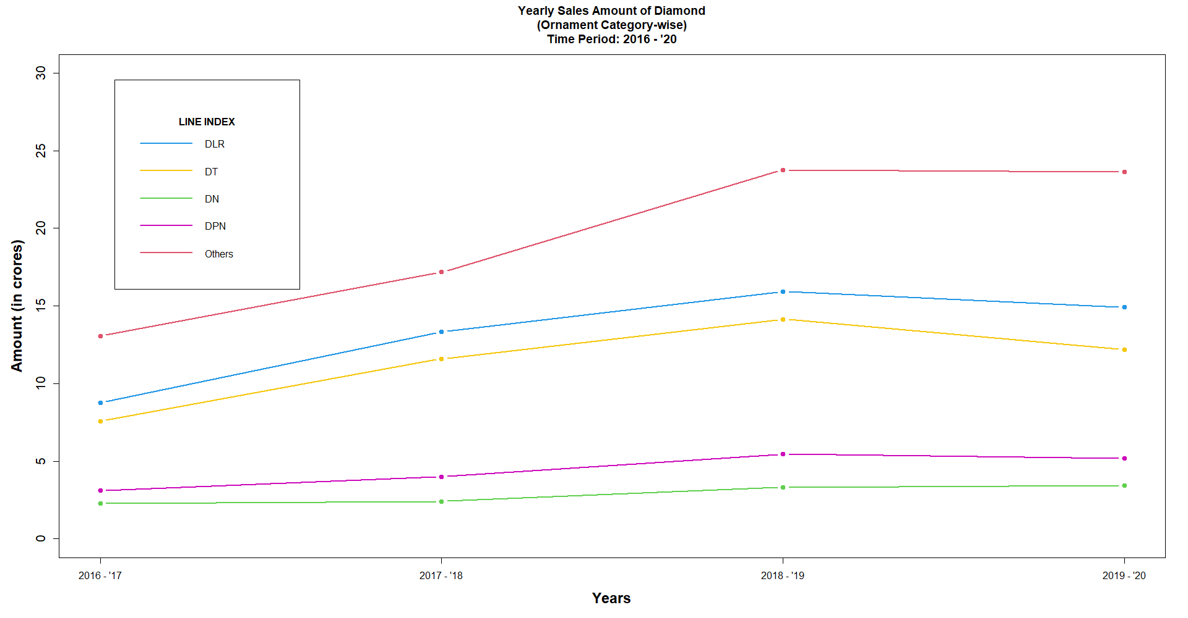

Slide 11
Comments :
DLR brings maximum revenue followed by DT, DPN and DN in respective order
Every category attains a peak in October-November of each financial year
DLR attains peak sales amount in October 2019, amounting to ₹2,17,76,636 (approximately 2.18 crores)
DT attains peak sales amount in October 2019,amounting to ₹2,11,25,249 (approximately 2.11 crores)
DPN attains peak sales amount in October 2019,amounting to ₹80,13,847
DN attains peak sales amount in October 2019,amounting to ₹59,12,997

Slide 12
Multiple line diagram of : PLATINUM
Categories under study :
i. PDR
ii. PC
iii. PDT
iv. PR
v. Others(20)

Slide 13
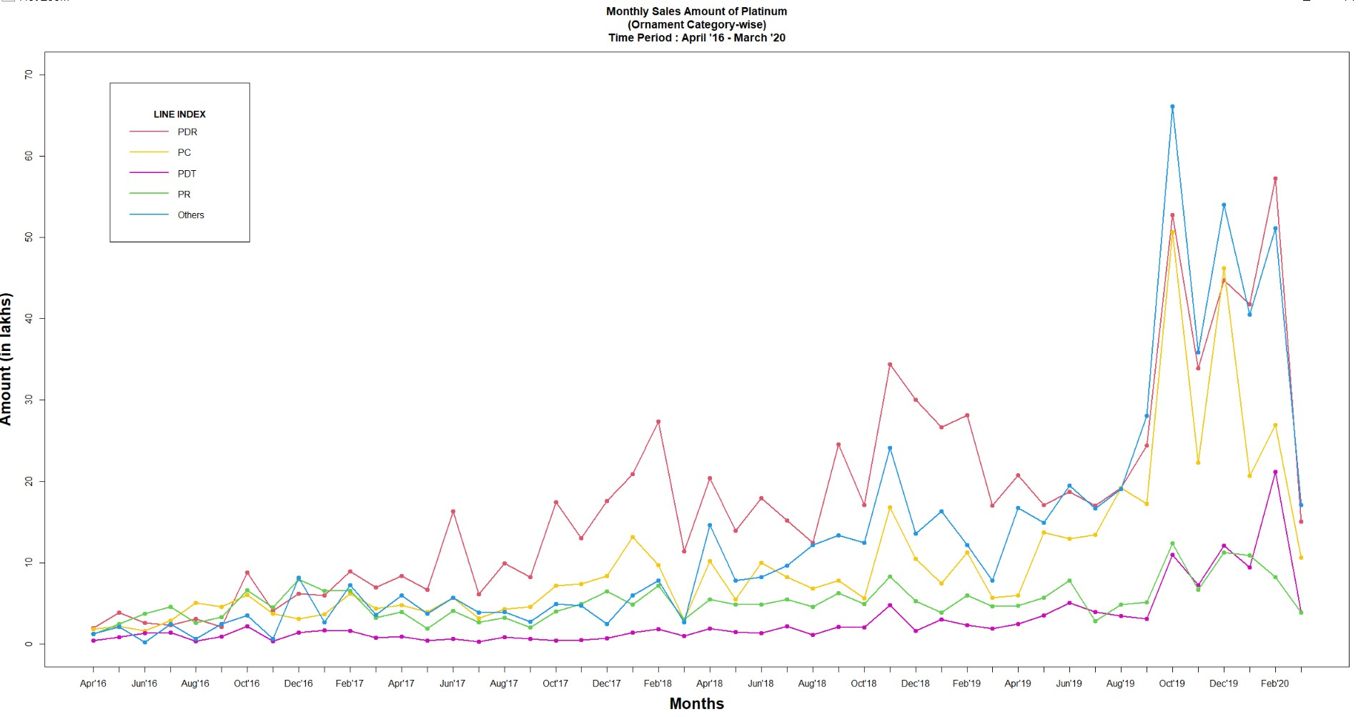

Slide 14
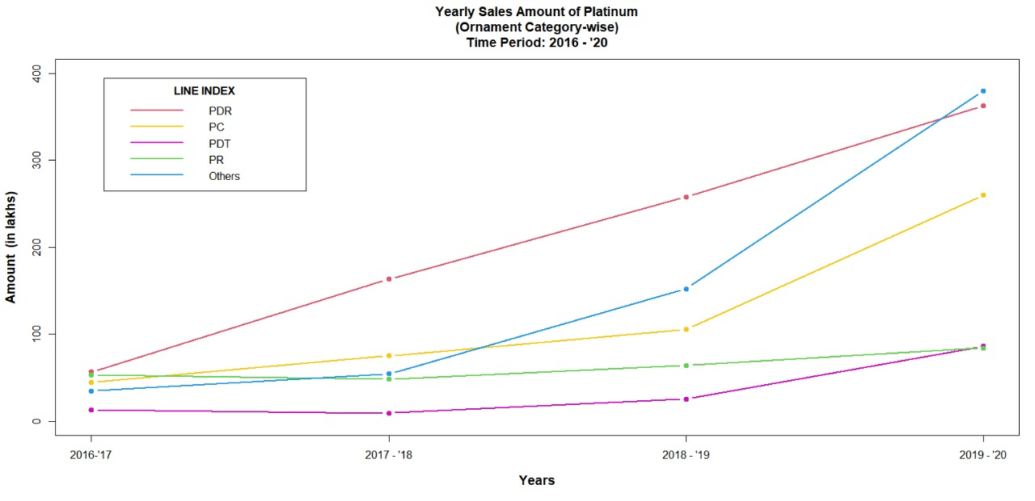

Slide 15
Comments :
PDR brings maximum revenue followed by PC, PR and PDT in respective order
The data indicates a general increase in sales amount for every category of Platinum over the four financial years. The rise is gradual in the years 2016-17, 2017-18 and 2018-19 and becomes steeper from September 2019 onwards.
PDR attains maximum sales amount in February 2020, amounting to ₹57,23,780
PC attains maximum sales amount in October 2019, amounting to ₹50,66,237
PR attains maximum sales amount in October 2019, amounting to ₹12,35,874
PDT attains maximum sales amount in February 2020, amounting to ₹21,14,509

Slide 16
Multiple line diagram of : SILVER
Categories under study :
i. SCO_SPO
ii. SMO_SPO
iii. SP_SPO
iv. SM_SU
v. Others(18)

Slide 17
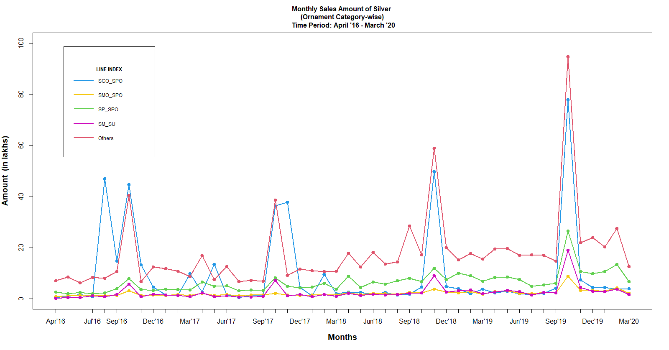

Slide 18
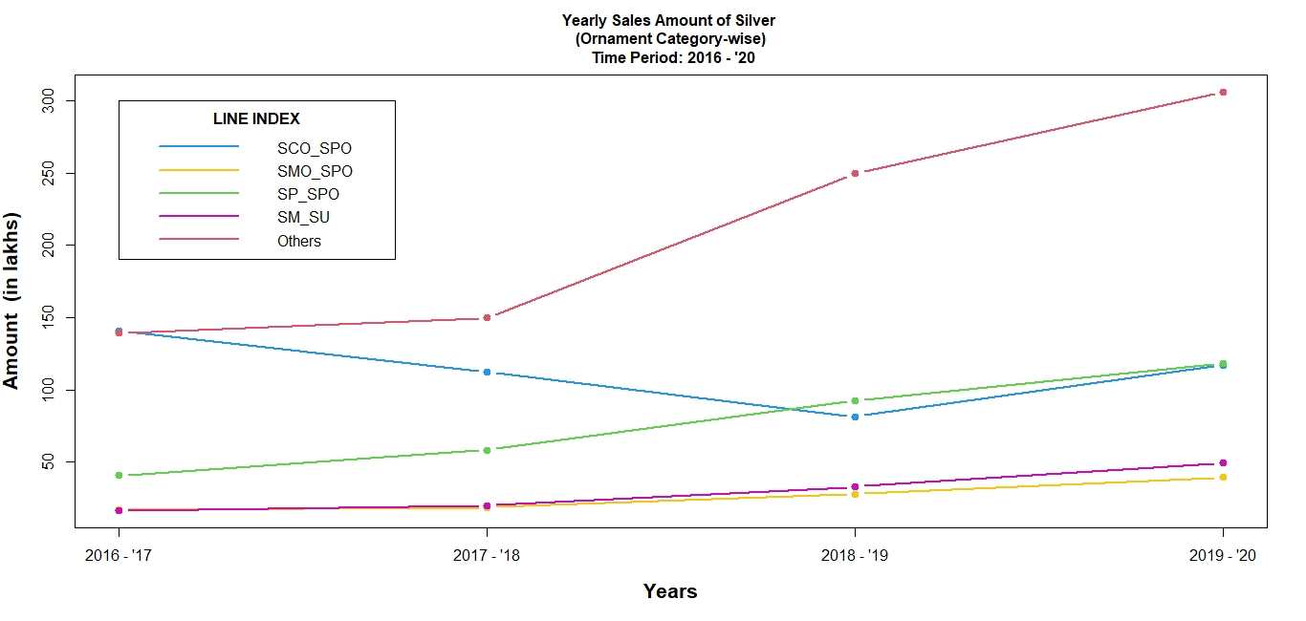

Slide 19
Comments :
Peaks are evident for each category in and around October-November
The category SCO_SPO attains absurd peaks in August ‘16, March ‘17, May ’17, November ‘17, February ’18
SCO_SPO attains maximum sales amount in October 2019, amounting to ₹77,89,077
SMO_SPO attains maximum sales amount in October 2019, amounting to ₹8,80,214
SP_SPO attains maximum sales amount in October 2019, amounting to ₹26,55,110
SM_SU attains maximum sales amount in October 2019, amounting to ₹18,96,695

